Slide 1
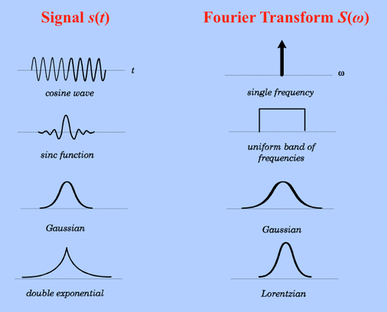
Fourier Transform
Harri Pahirathan
CSCD92

Slide 2
WHAT WE WILL BE LOOKING AT!
Basic Idea
History
Different Variations of it
Applications

Slide 3
WHAT IS IT! (BASE IDEA)

Slide 4
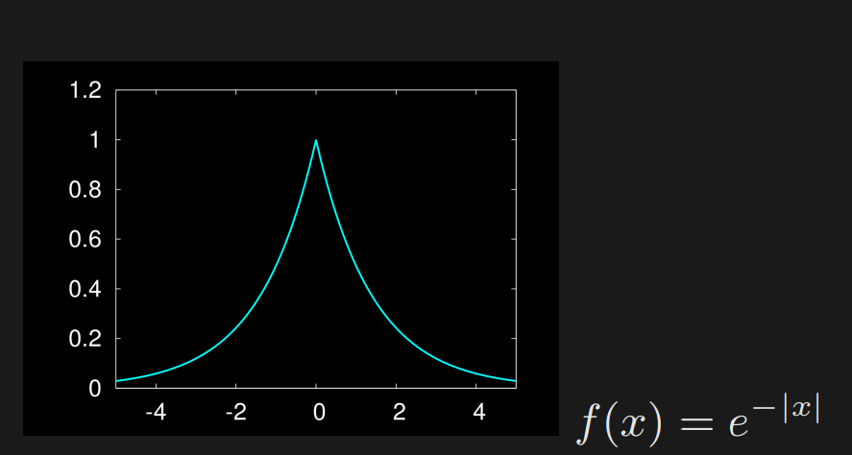
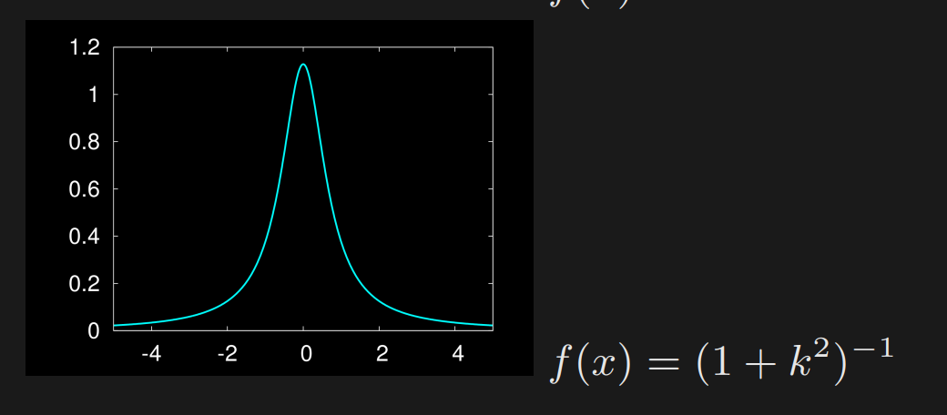
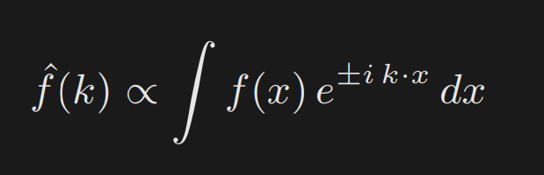

Slide 5

WHO?

Slide 6
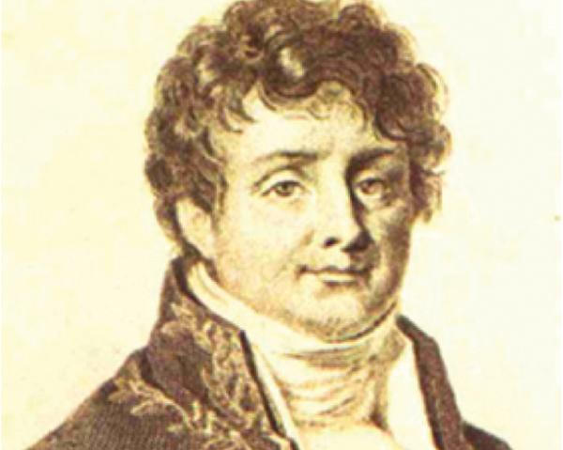
Jean Baptiste Joseph Fourier (1768–1830)

Slide 7
Different Transformation?
Discrete Fourier Transform
Fast Fourier Transform
Continuous and Discrete Fourier

Slide 8
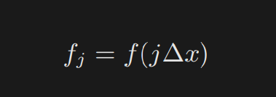
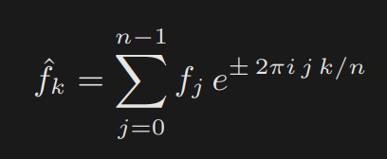
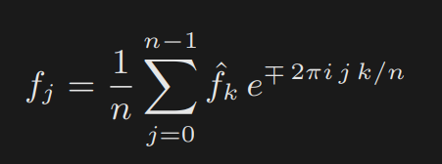
Discrete Fourier Transform

Slide 9
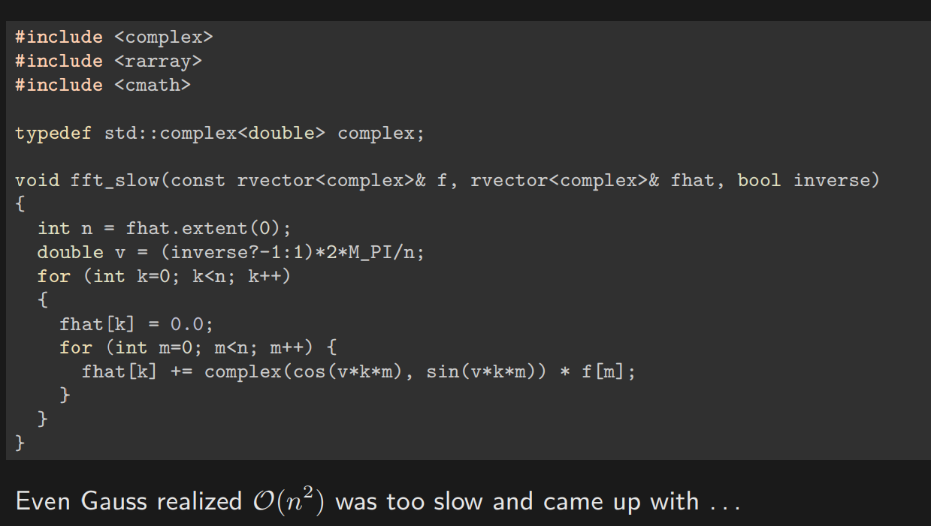

Slide 10
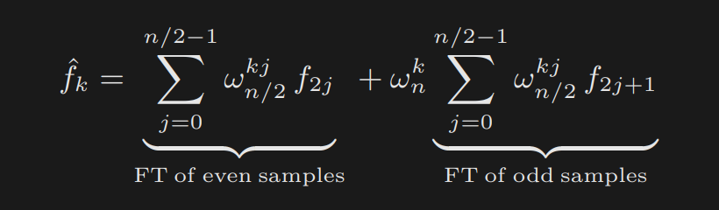
Fast Fourier Transform
A sum of two n/2 points FT for each n point
^2Log(n)
O(n log n)

Slide 11
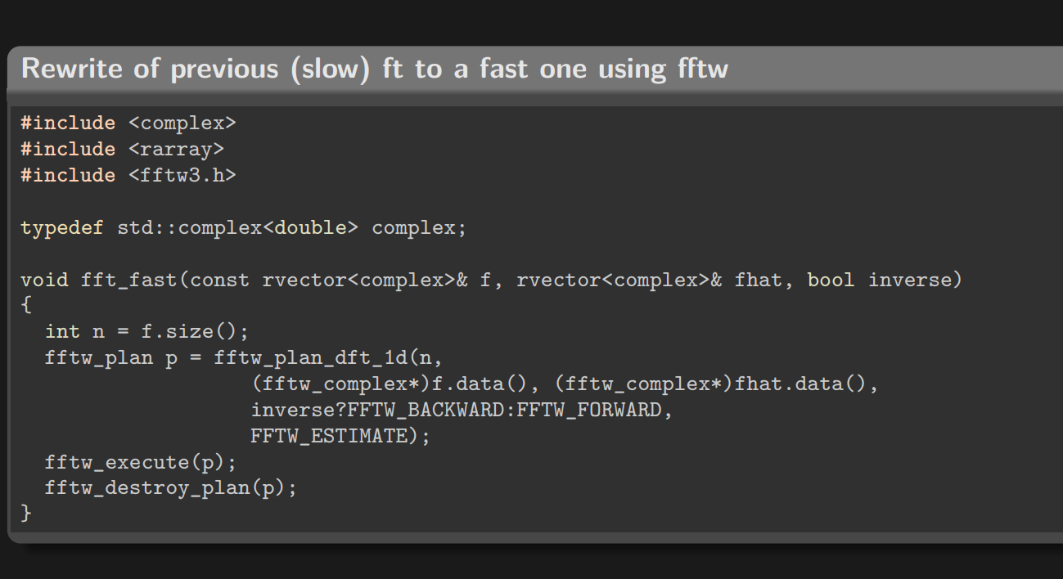

Slide 12
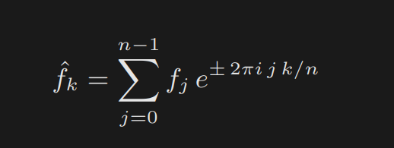
Continuous and Discrete Fourier
Continuous t∈R
Discrete n∈Z
Differences?

Slide 13
Applications of the Fourier Transform
Everywhere
Signals and Systems
Image Processing
Quantum Mechanics
Many More

Slide 14
References:
https://support.scinet.utoronto.ca/education/go.php/545/content.php/cid/2453/
https://www.embs.org/pulse/articles/highlights-in-the-history-of-the-fourier-transform/#:~:text=Surprisingly%2C%20this%20method%20for%20derivation,institute%20in%201811%20%5B11%5D
https://slideplayer.com/slide/5179240/
https://mriquestions.com/fourier-transform-ft.html
https://www.dsprelated.com/freebooks/sasp/Fourier_Transforms_Continuous_Discrete_Time_Frequency.html
https://commons.wikimedia.org/wiki/File:Fourier_transform_time_and_frequency_domains_%28small%29.gif
Part 2 lecture notes SciNet

